Slide 1

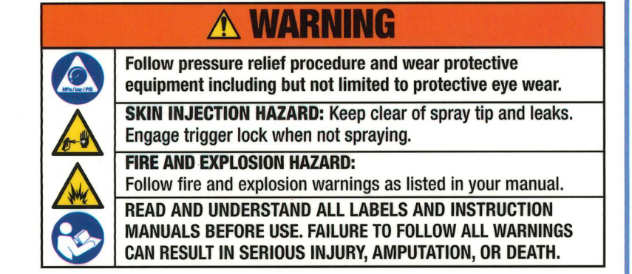
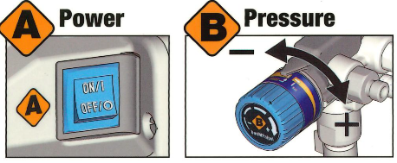
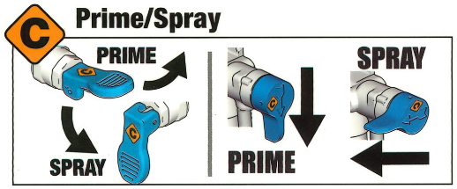
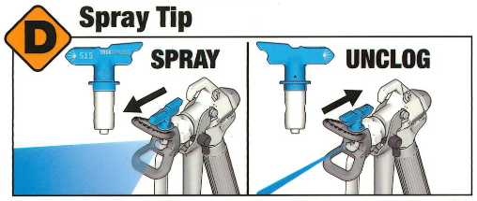
Airless Sprayer Instructions for use
Know Your Controls
Read Owner's Manual for complete instructions and warnings. This quick guide is not a substitute for reading and understanding all instruction manuals and warning labels supplied with the equipment. Manuals are available at graco.com
Start Up
1TumPower
Switch OFF and plug sprayer
into a .grounded outlet.
2 Separate Drain Tube (smaller) from Suction Tube (larger). Place Drain Tube in a waste pail. Submerge Suction Tube into pail filled with water tor water-based material, or mineral
spirits if spraying oil-based material.
6 Rotate Spray Tip to UNCLOG Position.Disengage Trigger Lock.
Point gun into waste pail,
pull and hold trigger.
Move Prime/Spray Valve
to SPRAY position and
turn Power Switch ON.
3 Move the Prime/Spray Valve to the PRIME position. Press the PushPrime button* twice
to loosen inlet valve ball. Turn Pressure Control Knob to START position. Turn Power Switch ON.
• Not available on all models.
4 Allow fluid to flow up the Suction Tube and out of Drain Tube for 30-60 seconds. Turn Power Switch OFF.
7 When paint comes out of gun,
release trigger. Engage Trigger
Lock. Transfer Drain Tube to paint pail
and attach to Suction Tube. Rotate
Spray Tip back to SPRAY position
and ensure Spray Tip Guard is tight.
5 Submerge Suction
Tube into paint. Turn
Power Switch ON and
watch for paint to come
out of the Drain Tube. Turn
Power Switch OFF.
You Are Now Ready To Spray

Slide 2
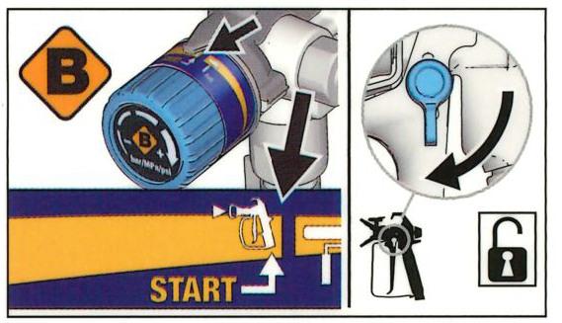
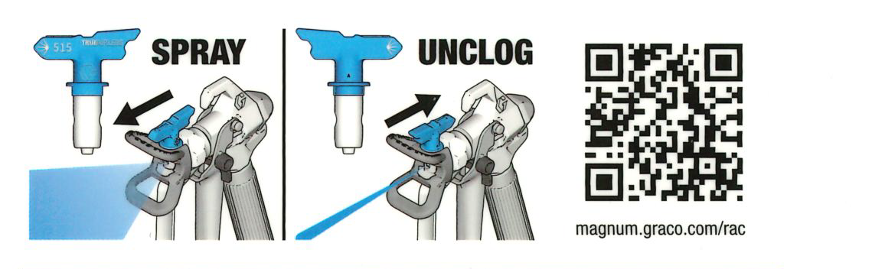
How To Spray
1 Turn Pressure Control Knob to the START position. Disengage the Trigger Lock.
2 Increase Pressure Control Knob if needed until spray is even and without gaps at edges.
Your sprayer is shipped with a Spray Tip to spray paint. If you are spraying stain see the store associate to purchase a smaller Spray Tip size. If_ your sprayer sto~s spraying, you most likely have a Spray Tip clog. Engage Trigger Lock and reverse the Spray Tip to the UNCLOG position. Disengage Trigger Lock and spray into a waste area to remove the clog. Engage Trigger Lock and return the Spray Tip to SPRAY position. See Owner's Manual for more information.
Clean Up
Water & Oil Based Paints/Stains
Before cleaning perform the pressure relief procedure. First engage the gun trigger lock, Power off the sprayer, Turn the pressure control to the lowest setting and reverse the spray tip, then disengage the gun trigger lock. Hold the gun over a waste bucket and pull the trigger to release pressure, then engage the gun trigger lock again. Next turn the prime spray valve to the prime position, remove the tip guard and tip, then remove the paint pick up tube from the paint. Give it a clean then put the paint suction tube into a bucket of water or turps (2L) if using an mineral oil based paint/stains. With the gun pointed into the paint bucket pull the trigger and put the prime /spray valve to spray. Keep holding the trigger and turn the sprayer on and increase the pressure until the paint starts to come out this should be at the lowest pressure on the dial, when it looks like water or turps is mixed in with the paint turn off the sprayer and release the gun trigger. Then hold the gun over the waste bucket, pull the trigger and then turn the sprayer back on, let the water/turps run through the gun and hose. After this initial clean out follow these steps. Water based clean up - Get a fresh bucket of water and repeat the process until the water is clean, this could take 1-3 buckets of clean water. - Once the water is clean, put the tip guard and tip back on and repeat the process to clean the out. - Once done, decrease the pressure completely while holding the gun trigger and turn it slowly back to prime and turn the sprayer off. Turps based clean up – Get a bucket of fresh turps (2-3L) and repeat the process, halfway through this process, put the tip guard and tip back on and put some turps through the tip. Get a bucket of water (4L-5L) put a couple of squirts of dishwashing liquid if you have it, take the tip guard and tip off and repeat the process. Get another bucket of just water (4L-5L) and repeat the process to wash the soapy water out. Hopefully the water will be clear after this, if it’s not get a fresh bucket of water and repeat the process. When it’s clear put the tip guard and tip back on and put some water through the tip to clean it out. Once done, decrease the pressure completely while holding the gun trigger and turn it slowly back to prime and turn the sprayer off

